Slide 1

Modeling Heteroskedasticity with ARCH/GARCH
STAT 7980 Special Project Fall 2023
Nitin Yadav

Slide 2
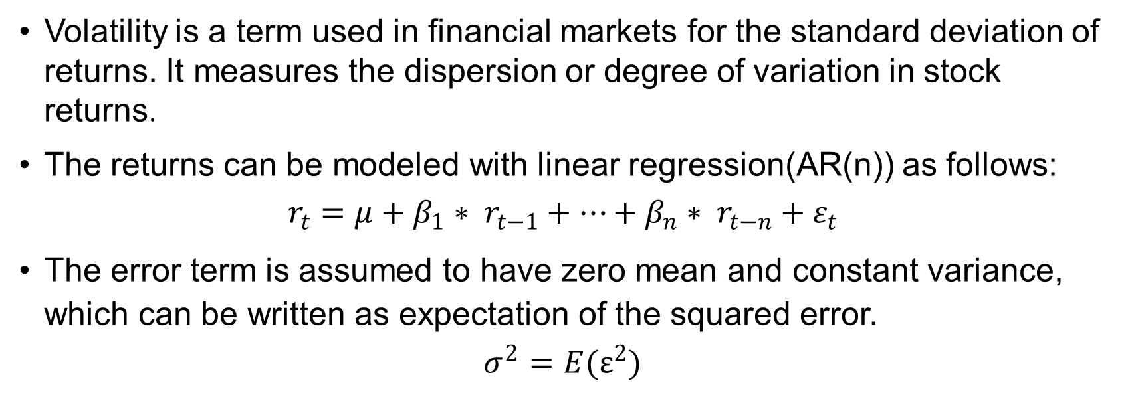
Volatility
Volatility is a term used in financial markets for the standard deviation of returns. It measures the dispersion or degree of variation in stock returns.
The returns can be modeled with linear regression(AR(n)) as follows:
$$r_{t}=μ+β_{1}∗ r_{t−1}+…+β_{n}∗ r_{t−n}+ε_{t}$$
The error term is assumed to have zero mean and constant variance, which can be written as expectation of the squared error.
$$σ^{2}=E(ε^{2})$$

Slide 3
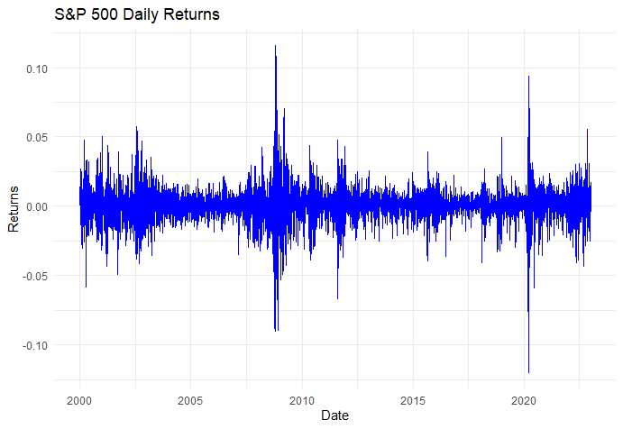
Volatility clustering
When financial markets undergo a substantial drop. The market gets into panic mode, which leads to a further fall in prices. An increase in variance from the initial price drop leads to significant further downward volatility.
“Large changes tend to be followed by large changes of either sign”
That is, an increase in variance is serially correlated to a further increase in variance in such a “sell-off” period.

Slide 4
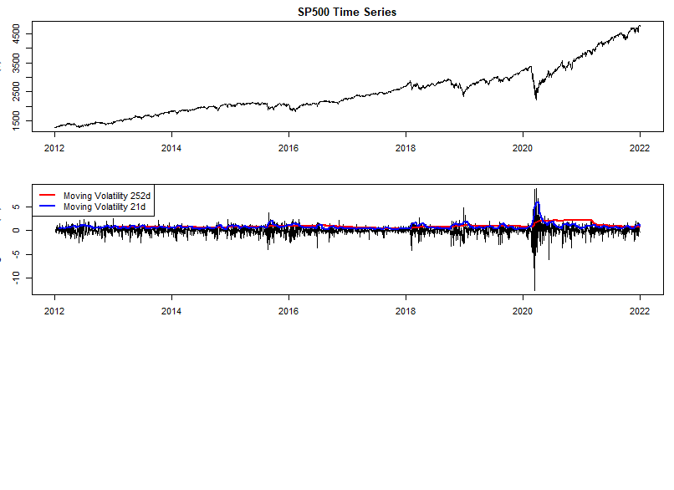
Leverage Effect
Changes in returns display a tendency to be negatively correlated with changes in volatility.
Over a time period, if changes in returns are positive, then changes in volatility are negative. This phenomenon is termed the “leverage effect”.
Volatility tends to rise in response to “bad news”(negative returns) and to fall in response to “good news” (positive returns).
Notes:
This is analogous to the human nature of seeking safety as soon as adverse conditions are sensed. Being in a long position is like staying in a risky place, when bad news comes, the investor sells the stock and gets money in exchange which is safer than the stock.

Slide 5
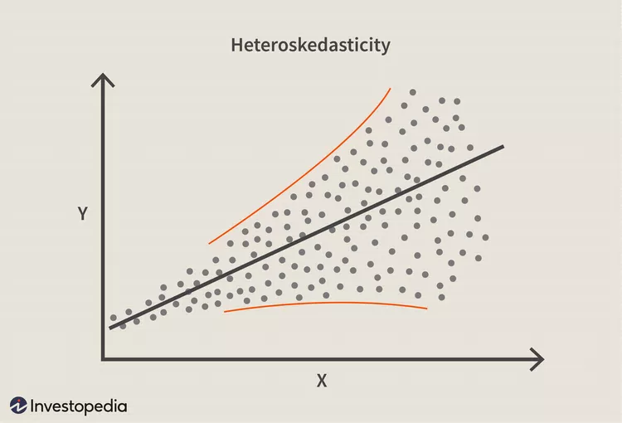
Heteroskedasticity
Heteroskedasticity occurs when the variance of error terms is dependent on the predictor variables. In the context of financial data, the variance is volatility and predictor variables are lagged returns, i.e., time.
So, a financial time series is heteroskedastic if the expected value of squared error(variance) changes with time.
When the volatility is not constant, we expect more outliers, it will follow heavy-tailed or outlier-prone probability distributions.
A period of increased volatility is conditional on an initial sell-off. Thus, we say that such series are conditionally heteroskedastic.

Slide 6
Need for modeling
Modeling and forecasting accuracy is generally enhanced with the addition of more data points.
Unfortunately, financial data cannot be created ahead of time. Hence, a prediction model, no matter how rudimentary or advanced, is necessary to digest the historical information and forecast the next day’s value.
Given T days of data, the model will digest a certain amount of information, leading to a prediction value for the T+1 day.
ARCH/GARCH models address this issue by modeling the conditional heteroskedastic nature of volatility using the Autoregressive(AR) concept of time series.

Slide 7
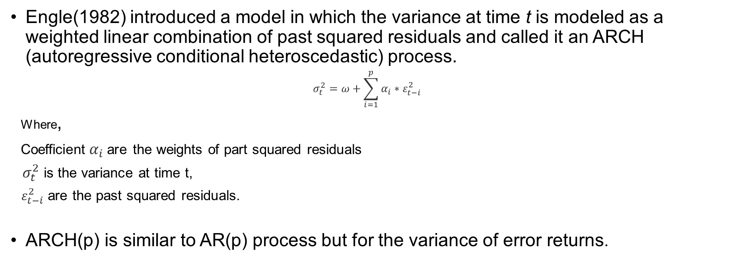
ARCH
Engle(1982) introduced a model in which the variance at time t is modeled as a weighted linear combination of past squared residuals and called it an ARCH (autoregressive conditional heteroscedastic) process.
$$σ_{t}^{2}=ω+\sum_{i=1}^{p}{α_{i}∗ε_{t−i}^{2}}$$
Where,
Coefficient$α_{i}$are the weights of part squared residuals
$σ_{t}^{2}$ is the variance at time t,
$ε_{t−i}^{2}$ are the past squared residuals.
ARCH(p) is similar to AR(p) process but for the variance of error returns.

Slide 8
ARCH(p) and/or ARCH(q)
An obvious question that comes at this stage is if we are going to apply this process to the squared residuals, why not to the past variance as well? Or a mixed model such as ARMA(p,q)?
This is actually the motivation for the Generalized ARCH model, known as GARCH.
If the PACF of the squared residuals suggests AR(p), then ARCH(m) may work.
GARCH models are suggested by an ARMA(p,q) nature of the ACF and PACF of squared residuals.

Slide 9
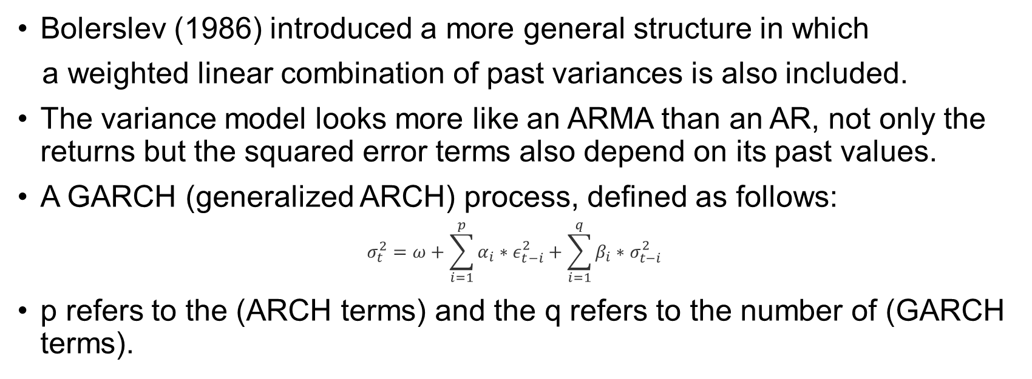
GARCH(p,q)
Bolerslev (1986) introduced a more general structure in which
a weighted linear combination of past variances is also included.
The variance model looks more like an ARMA than an AR, not only the returns but the squared error terms also depend on its past values.
A GARCH (generalized ARCH) process, defined as follows:
$$σ_{t}^{2}=ω+\sum_{i=1}^{p}{α_{i}∗ε_{t−i}^{2}}+\sum_{i=1}^{q}{β_{i}∗σ_{t−i}^{2}}$$
p refers to the (ARCH terms) and the q refers to the number of (GARCH terms).

Slide 10
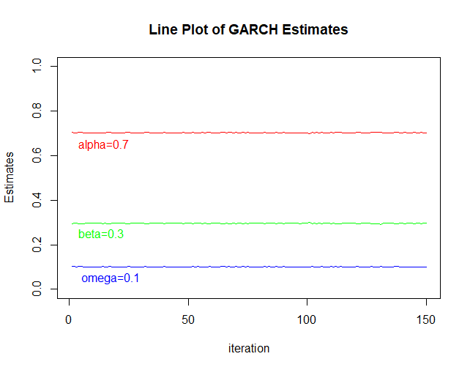

Simulation using Definitions
 | ARCH Simulation | ARCH Model | GARCH Simulation | GARCH Model
Omega | 0.1 | 0.0993 | 0.1 | 0.101
Alpha | 0.7 | 0.718 | 0.7 | 0.703
Beta |  |  | 0.3 | 0.295
Data was generated using simulation of ARCH(1) with the parameters, $ω=0.1,α=0.7$ and GARCH(1,1) with $ω=0.1,α=0.7,β=0.3$ using the previously defined formulas.
ARCH(1) and GARCH(1,1) model were fitted on sampled time series iteratively to estimates coefficients.
Here is a comparison table of mean estimates and true parameters.
Also, the line plot shows that the estimates are distributed precisely close the true value.

Slide 11
Distribution and Asymmetry
Standard GARCH model assumes that the distribution of returns is normal but due to the leverage effect, distribution is skewed and volatility clustering leads to heavy tails.
Skewed student t-distribution captures these deviations by a skewness and shape parameter.
The GJR variant of GARCH model captures the leverage effect by adding a categorical variable in favor of negative returns since bad news has a greater effect on volatility.

Slide 12
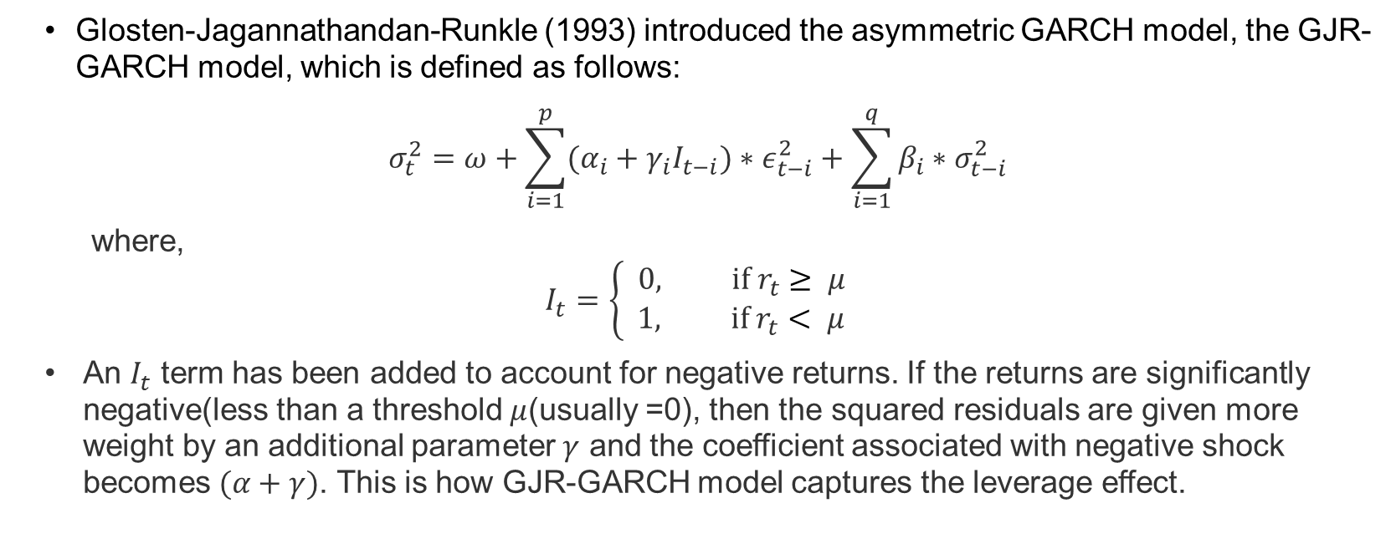
GJR- GARCH
Glosten-Jagannathandan-Runkle (1993) introduced the asymmetric GARCH model, the GJR-GARCH model, which is defined as follows:
$$σ_{t}^{2}=ω+\sum_{i=1}^{p}{(α_{i}+γ_{i}I_{t−i})∗ε_{t−i}^{2}}+\sum_{i=1}^{q}{β_{i}∗σ_{t−i}^{2}}$$
where, $$I_{t}=\left\{\begin{aligned} 0, if r_{t}≥ μ \\ 1, if r_{t}< μ\end{aligned}\right.$$
An $I_{t}$ term has been added to account for negative returns. If the returns are significantly negative(less than a threshold $μ$(usually =0), then the squared residuals are given more weight by an additional parameter $γ$ and the coefficient associated with negative shock becomes $(α+γ)$. This is how GJR-GARCH model captures the leverage effect.

Slide 13
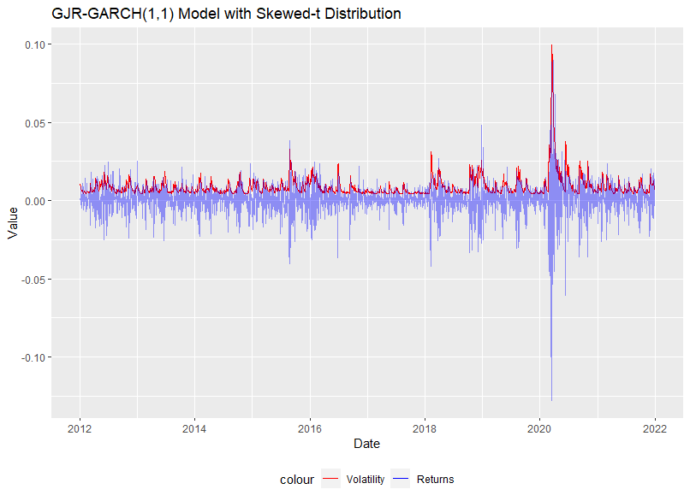

GJR- GARCH Results
The GJR-GARCH(1,1) model was fitted on SP500 data(2012-12) using skewed student-t distribution and with constant mean assumption, and the estimated parameters are used to write the following equation for variance at time T+1, using the information at time T:
$$σ_{t+1}^{2}=0.000004+(0.000005+0.372785 I_{t})∗ε_{t}^{2}+0.788373∗σ_{t}^{2}$$

Slide 14
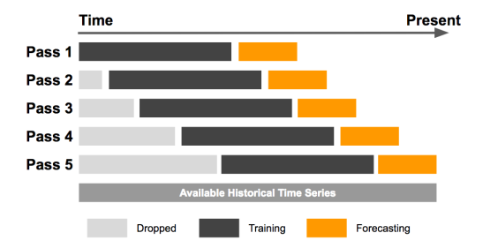
Volatility Forecasting
Fixed rolling window forecast: new data points are added while old ones are dropped from the sample. Here, historical data from 2012-2017 is used for the first estimation.
The GJR-GARCH model is fitted on a window of 5 years of data and volatility is forecasted for the next 3 days. The process is illustrated in the figure.
In the next iteration, actual data for 3 days is included, and the oldest 3 days data is discarded.

Slide 15
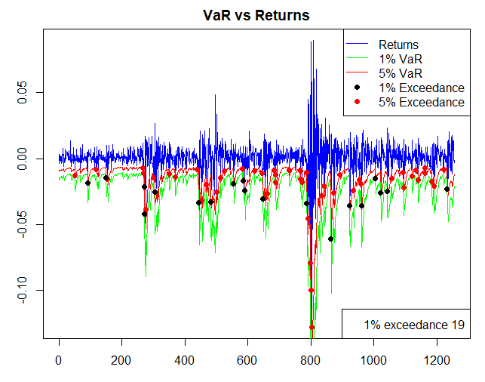
Value at Risk(VaR)
VaR is a statistical measure used to quantify the level of financial risk.
For example, a 1-day 1% VaR of $1 million means that there is 1% probability the portfolio will fall in value by 1 million dollars or more over a 1-day period. Stated the other way, there is 99% probability that the portfolio will not lose the calculated value or more in one day period.
For 5 years of data, the total expected exceedance points are 13 but the forecasted VaR exceeds 19 times. There are exceedance points 1.5% exceedance points at the 1% level. Thus, the model is underestimating the risk a little bit.

Slide 16
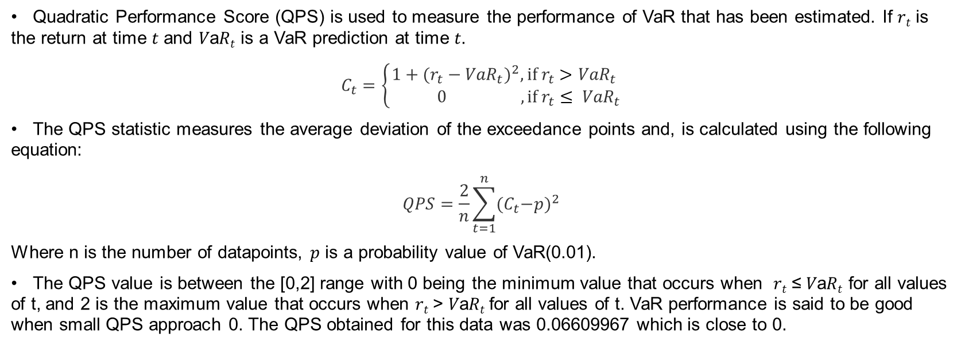
Back-testing Performance
Quadratic Performance Score (QPS) is used to measure the performance of VaR that has been estimated. If 𝑟_{𝑡} is the return at time 𝑡 and 𝑉a𝑅_{𝑡} is a VaR prediction at time 𝑡.
$$C_{t}=\left\{\begin{aligned}1+{(r_{t}−{VaR}_{t})}^{2},if r_{t}>{VaR}_{t} \\ 0 , if r_{t}≤ {VaR}_{t}\end{aligned}\right.$$
The QPS statistic measures the average deviation of the exceedance points and, is calculated using the following equation:
$$QPS=\frac{2}{n}\sum_{t=1}^{n}{{{(C}_{t}−p)}^{2}}$$
Where n is the number of datapoints, 𝑝 is a probability value of VaR(0.01).
The QPS value is between the [0,2] range with 0 being the minimum value that occurs when 𝑟_{𝑡} ≤ 𝑉a𝑅_{𝑡} for all values of t, and 2 is the maximum value that occurs when 𝑟_{𝑡} > 𝑉a𝑅_{𝑡} for all values of t. VaR performance is said to be good when small QPS approach 0. The QPS obtained for this data was 0.06609967 which is close to 0.

Slide 17
Conclusion
Heteroskedasticity is addressed in the context of financial data by applying the GJR-GARCH model with a constant mean to estimate Value at Risk (VaR).
Primary objective was to enhance risk measurement and forecasting performance through the consideration of the leverage effect – a phenomenon capturing the asymmetrical impact of positive and negative shocks on volatility.
The empirical findings reveal a robust performance in modeling volatility, as evidenced by the relatively similar exceedance points and small QPS score.

Slide 18
Further work
Mean-Variance Optimization developed by Markowitz, also known as Modern Portfolio Theory (MPT), can be used to construct an optimal portfolio that maintains a certain expected return for a given level of risk.
Algorithmic trading can be implemented by exploiting dynamic forecasting of volatility from the GARCH model and placing the trading orders algorithmically to adjust the weights of assets in a portfolio.

Slide 19
Questions?

Slide 20
I have a question
If the bad news makes the market more volatile as compared to the good news, the skewness in the distribution must be on the negative side and the bell shape(peak) should be slightly on the positive side.
Meaning, more frequent, small, positive returns are expected, and less frequent large negative returns are expected, because the prices increase gradually and drop abruptly.

